Slide 1
Radial Expansion Tester
Michael Bransky, Noah Keyes, Vergil Sorg

Slide 2


Project Introduction
POBA Medical is a local medical device company that specializes in medical balloon manufacturing
These balloons are formed by applying heat, pressure, and axial load into a plastic extrusion
POBA Medical has requested the team design a machine that can test an extrusions ability to form into a medical balloon
This will allow them to test stock of various different material and sizes before fully committing to buying a large amount of extrusions and new tooling
Notes:
Michael

Slide 3
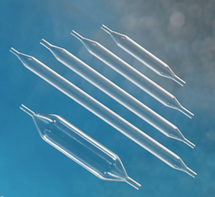
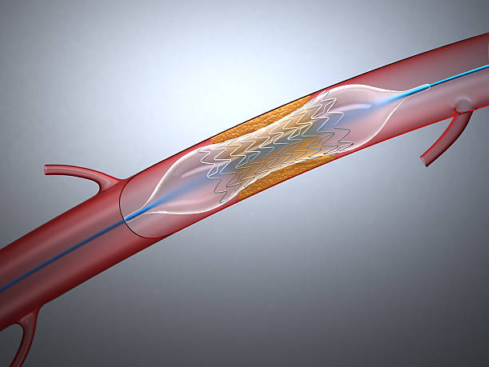
What is a Medical Balloon?
Medical balloons are used in a minimally invasive procedure called an “Angioplasty”
They are inserted into an artery in order to restore blood flow by either widening the passage or by expanding a stent mesh into the desired location
Can come in various shapes and sizes according to what application they will be made for
Notes:
Vergil

Slide 4
Engineering Requirements and Reasoning
This machine will need to accomplish the following tasks
  Pressurize a plastic extrusion up to 300 psi
  Apply up to 150 lbs of axial force with minimal slippage
  Test unexpanded diameters of .02-.625”
  Measure expanded diameters up to 2.5”
  Control the temperature of a 2 inch length of extrusion up to 250°F
  Output diameter measurement in an easy to read format
  Output temperature measurement in an easy to read format
Notes:
Noah

Slide 5
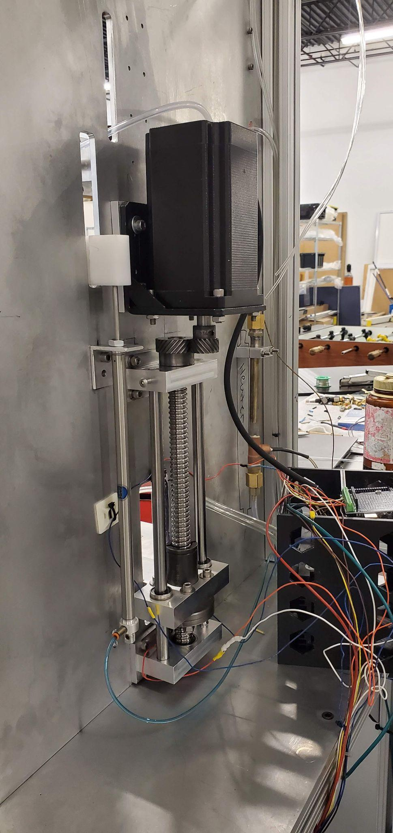
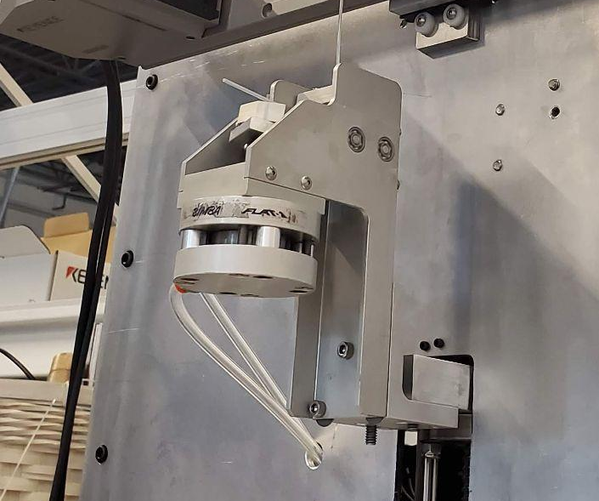
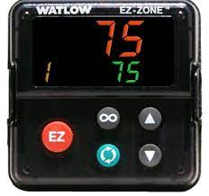
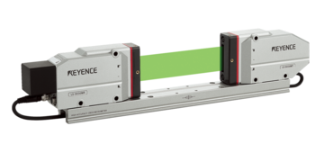
Design/Decision Making Process
Based off the project description and meetings with Poba engineers, the overall function of the device was broken down into a few subsystems
The team examined existing machinery at Poba Medical to see how they performed similar functions to each subsystem
Axial Loading
Temperature Control
Diameter Measurement
Clamping

Slide 6
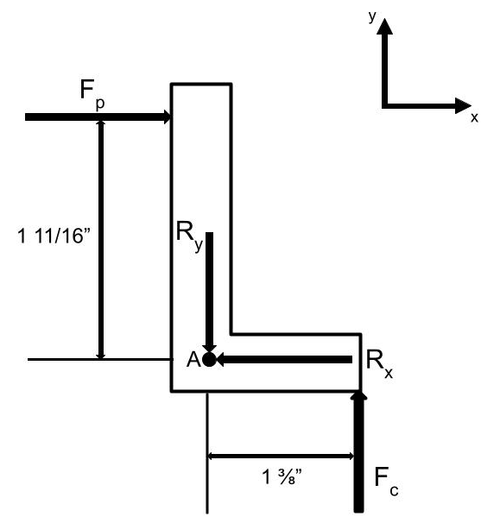
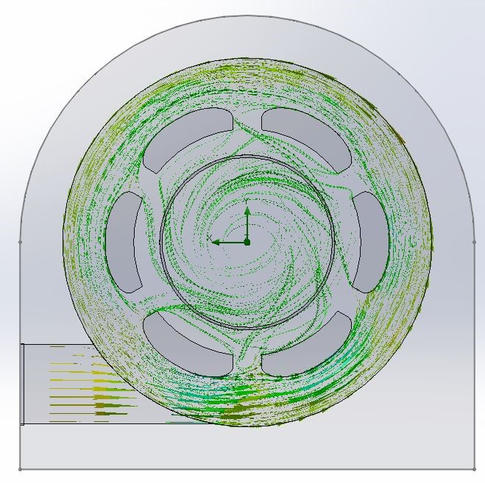

Design/Decision Making Process
A morphological matrix was used to generate designs that seemed to meet all of the design requirements
The team then performed a series of engineering analyses to quantitatively verify that the design would meet the requirements

Slide 7
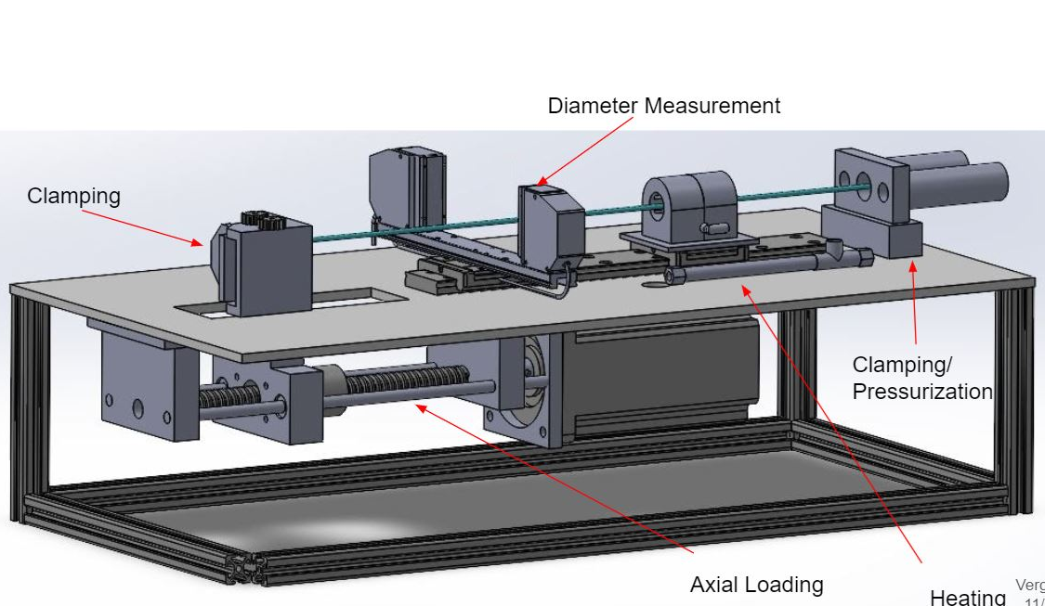
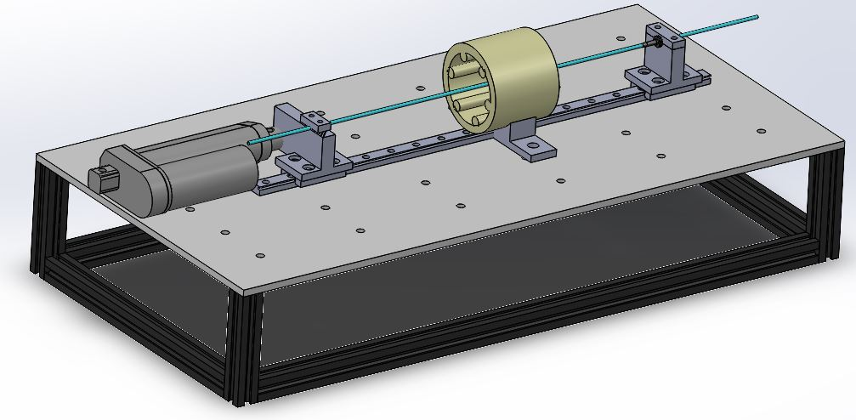
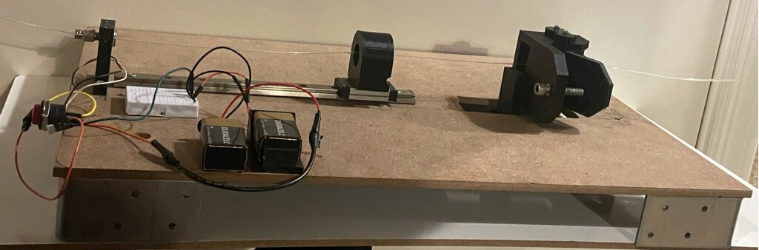
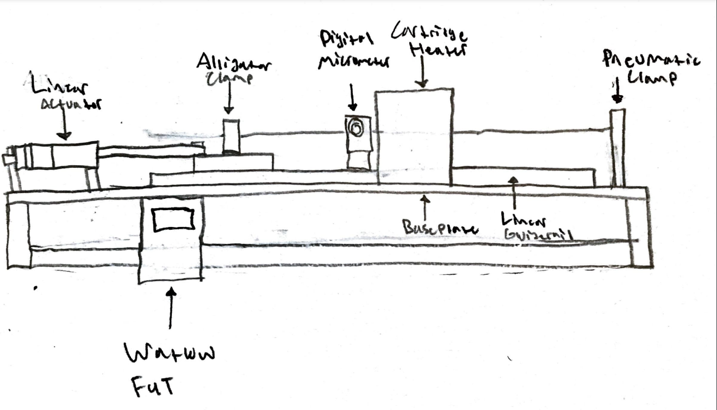
Early Designs
Notes:
Vergil

Slide 8
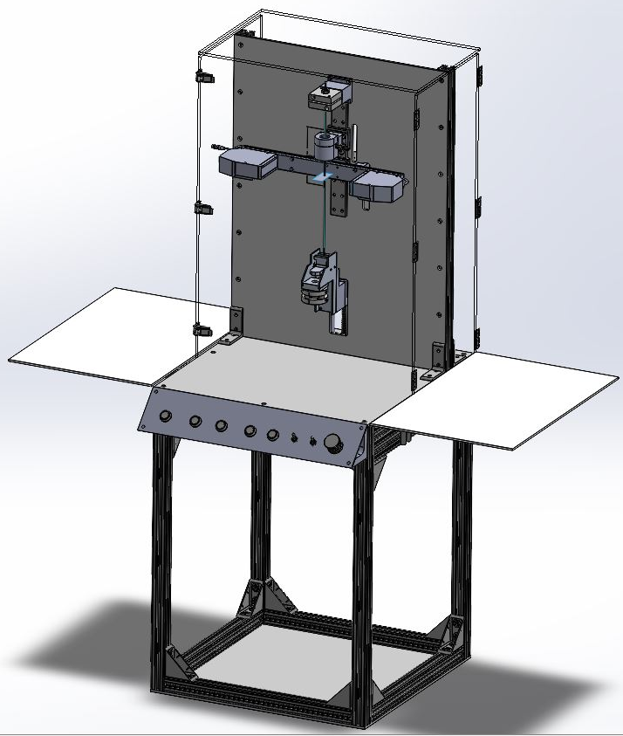
Design Solution - Overview
150 Lbf Axial Loading: Nema-34 Stepper motor driving a ball screw that drives a carriage with a clamp attached
This is what “Stretches” the extrusion so that a balloon can form in the heated area
250 F Temperature Control: Omega AHP-5051 duct heater supplying hot air which flows around the extrusions through a custom nozzle
This softens a 2” section of the extrusion so that the pressurized nitrogen can inflate it
Up To 2.5” Diameter Measurement: Keyence LS-7070 Laser Micrometer
This devices travels along a linear guide rail so that it can measure the profile and record its size
Clamping: Bimba Pneumatic Clamps
One end of the extrusion is “sealed off” while the other end is pressurized and held in place
Notes:
Noah

Slide 9
Design Solution - Axial Loading System Description
Axial Load is supplied by a Nema-34 stepper motor driving a ball screw, which is driving a carriage attached to a pneumatic clamp
Ball Screw mounts are CNC milled
Pneumatic clamp will clamp on to balloon so when system is activated balloon will be stretched
Motor is run by a driver-arduino setup
Motor will apply a 1:1.5 gear ratio, both spacing the ball screw favorably and applying more axial force to the extrusion
Notes:
Michael

Slide 10
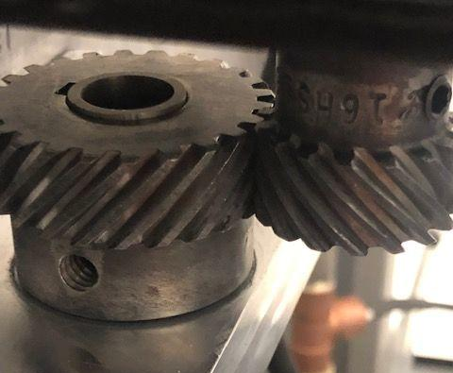
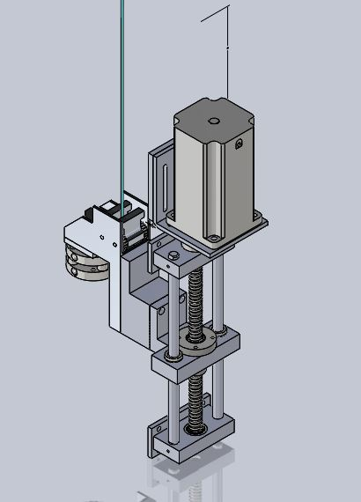
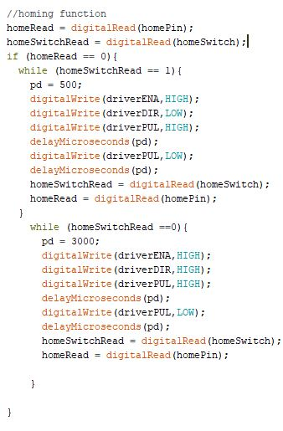
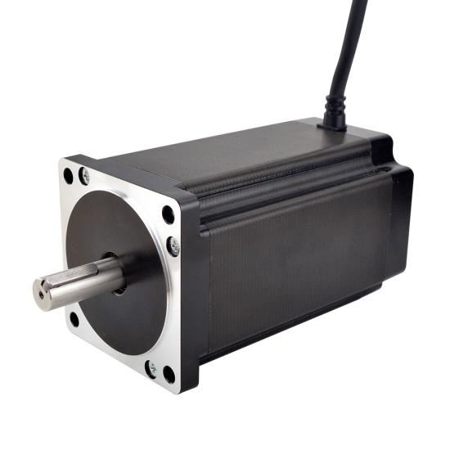
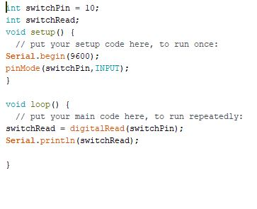
Design Solution- Axial Loading System
Limit switches were installed to ensure that ball screw did not strip if system was ran into baseplate
Arduino System was fully coded by team to ensure all buttons worked and motor could jog up, down, and home properly
Spacer was built to ensure that gears meshed properly
Notes:
Michael

Slide 11
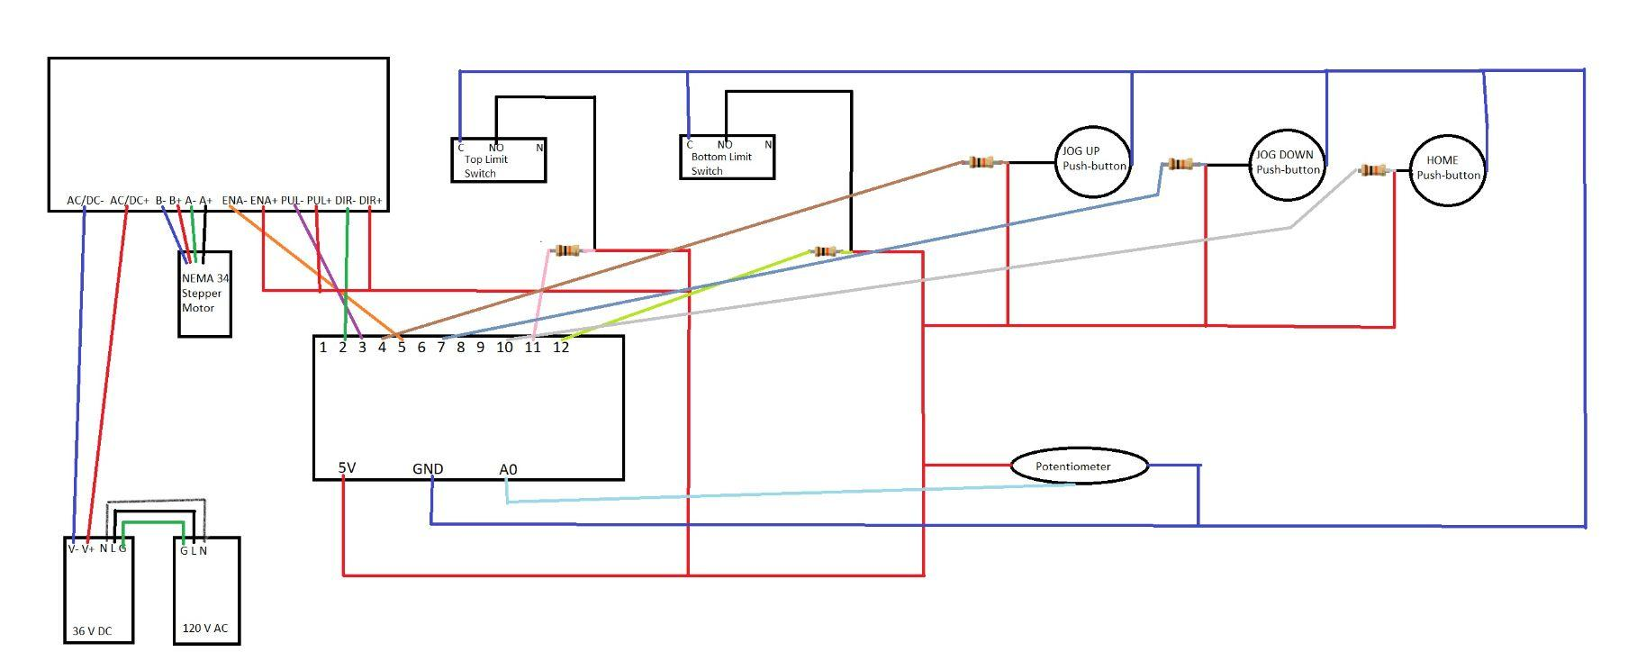
Design Solution - Axial Loading System Electric Diagram
Notes:
Michael

Slide 12
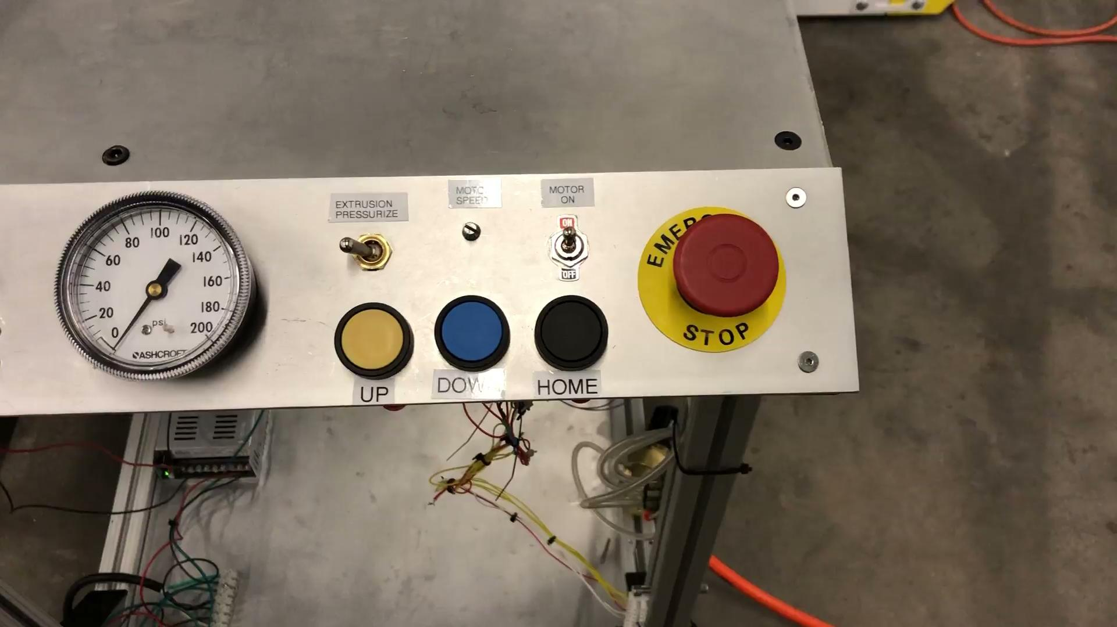
Design Solution - Axial Loading System Video
Notes:
Michael

Slide 13
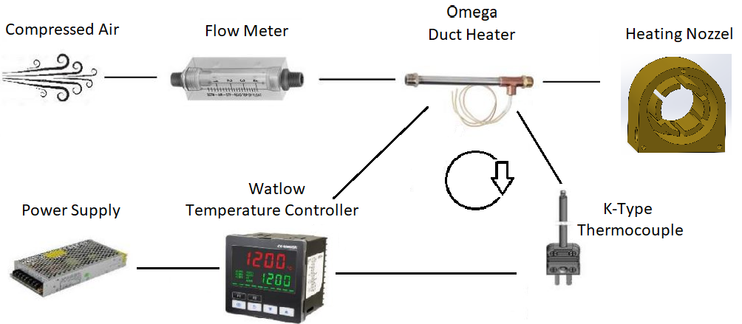
Design Solution - Heating Subsystem
The extrusion are heated by an Omega “AHP 5015” duct heater which heats flowing air
This airflow is adjustable from 0-8 CFM
Temperature control is achieved through a “Watlow Ez-Zone” temperature controller incorporating feedback from a K-Type Thermocouple affixed at the outlet of the heater
Notes:
Vergil

Slide 14
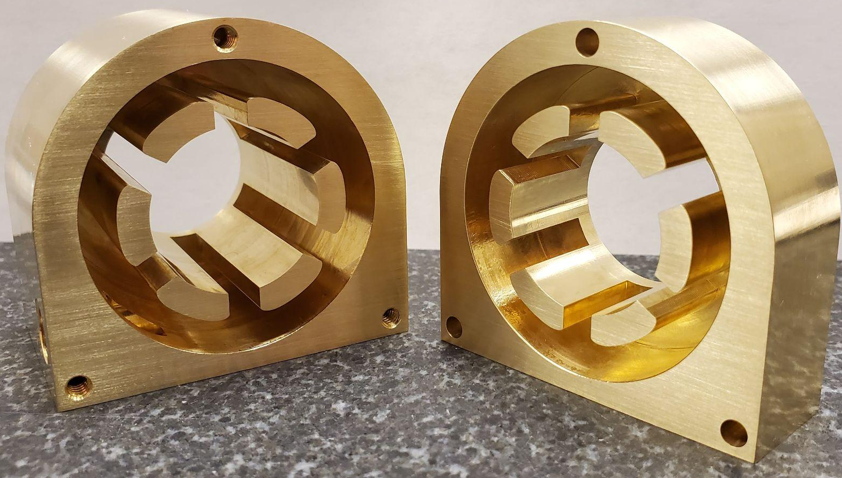
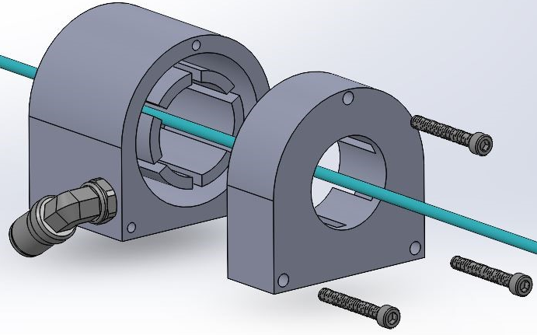
Heating Nozzle Analysis
Iterative CFD analysis was performed to optimize the flow distribution at the outlet to the extrusions
Brass was chosen for its good thermal conductivity when weighed against its cost and machinability.
Notes:
Vergil

Slide 15
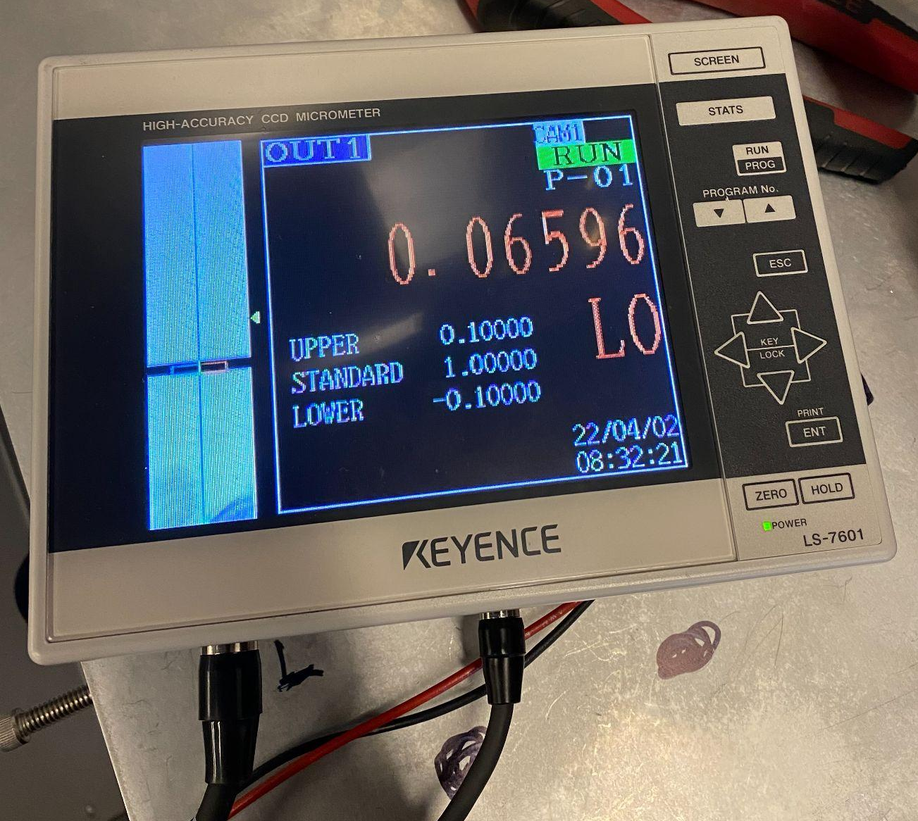
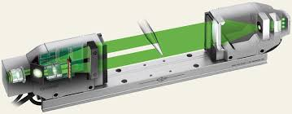
Design Solution - Diameter Measurement Subsystem
Measurement of extrusion diameters is done by a Keyence LS-7070 optical micrometer
This provides continuous measurements throughout the expansion of an extrusion that are accurate to 0.00001 in.
Measurement window provides leeway in position of micrometer relative to the point of maximal expansion on the extrusion
Notes:
Noah

Slide 16
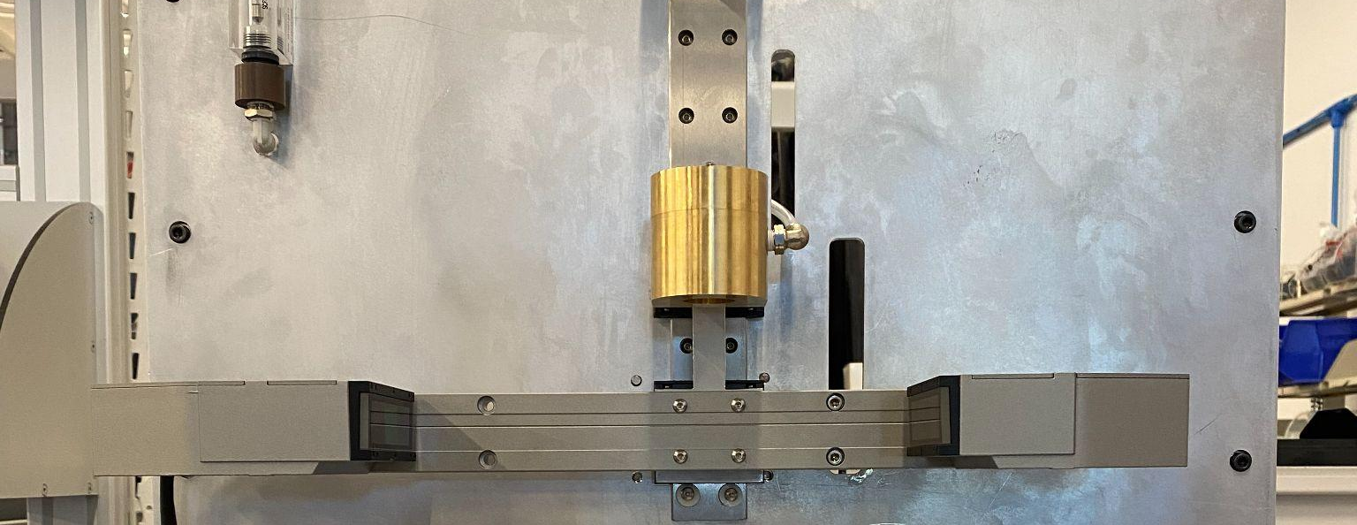
Design Solution - Diameter Measurement Subsystem
Micrometer is mounted to a linear guide rail w/ carriages and a CNC milled mount
An air cylinder pushes the micrometer into position to take measurements while simultaneously moving the heater nozzle out of the way
Notes:
Noah

Slide 17
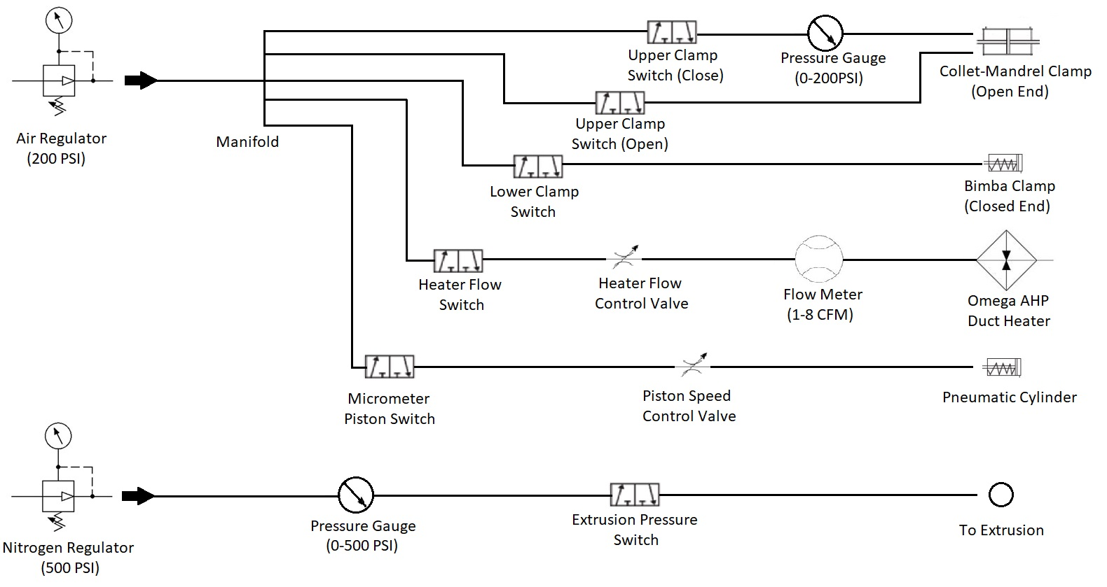
Pneumatic System Diagram

Slide 18
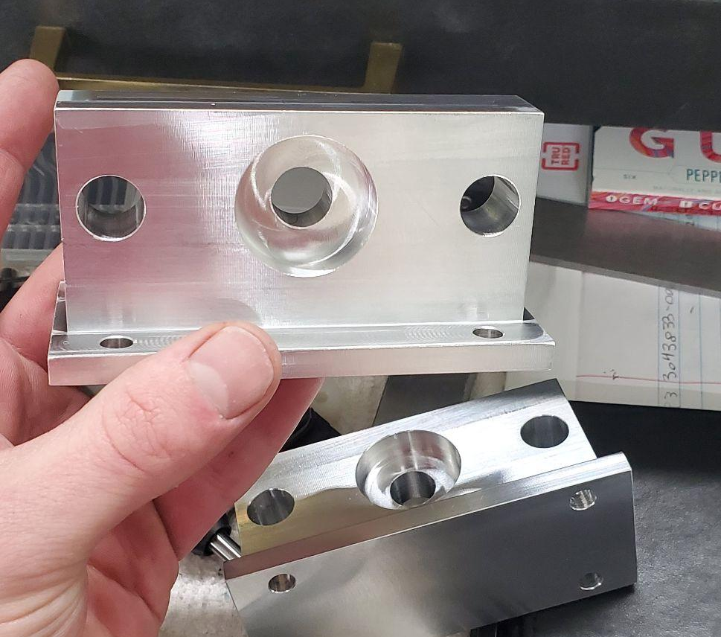
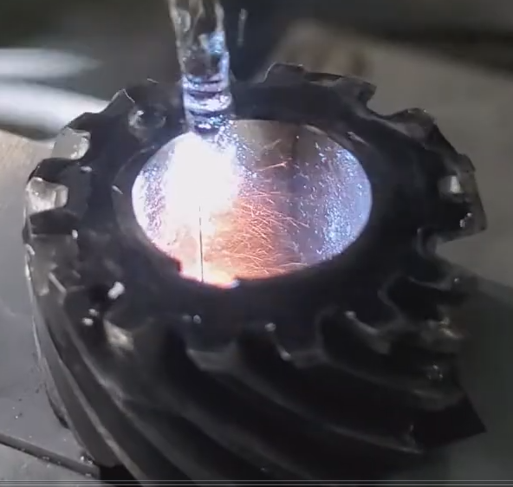
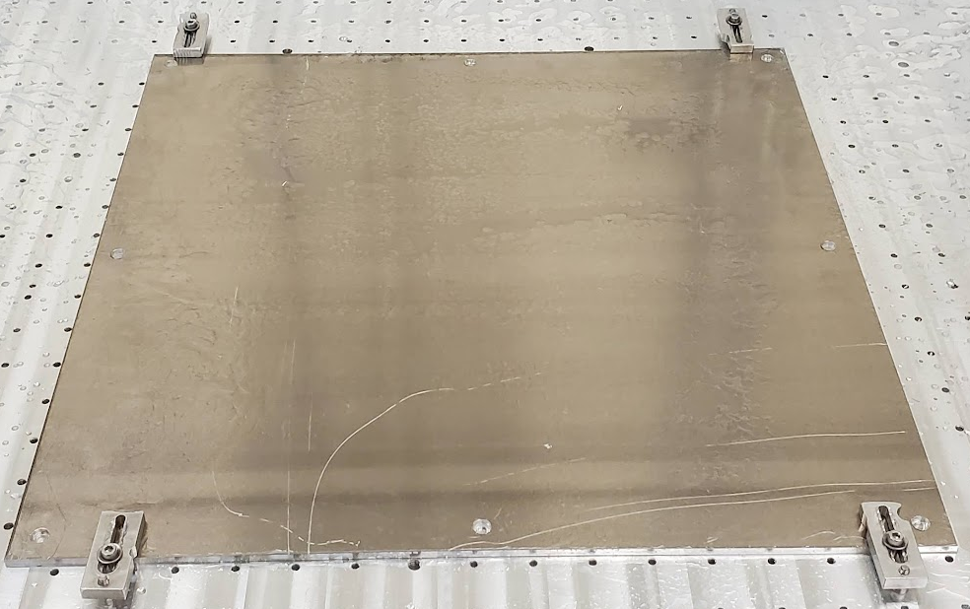
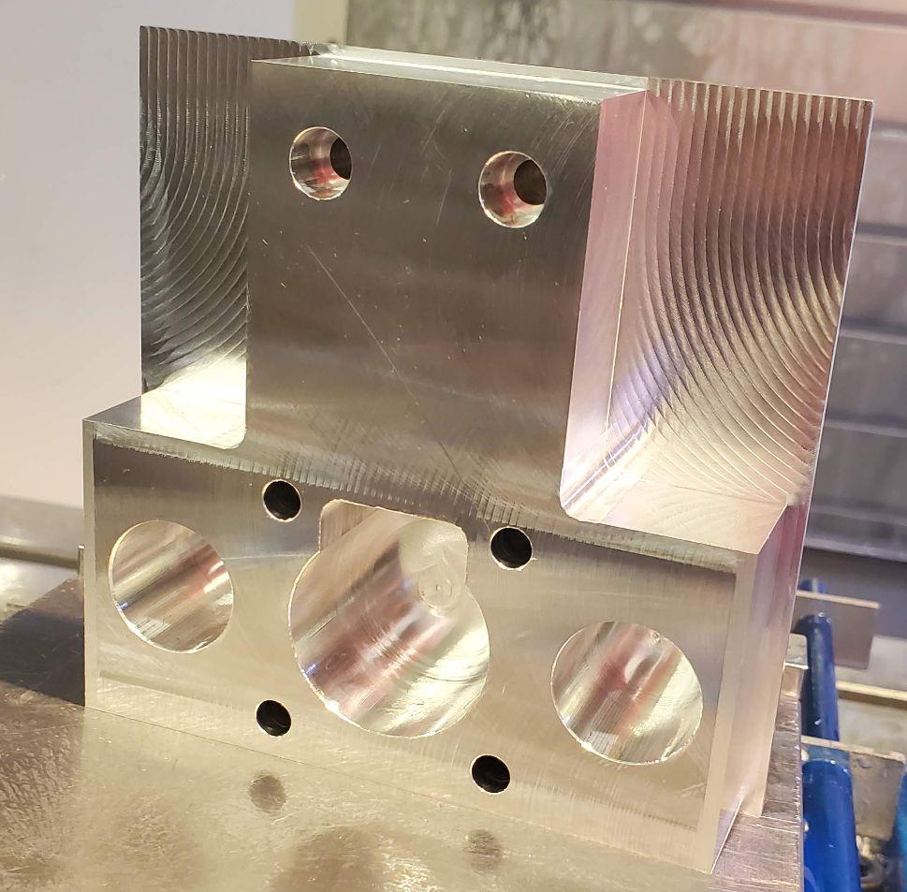
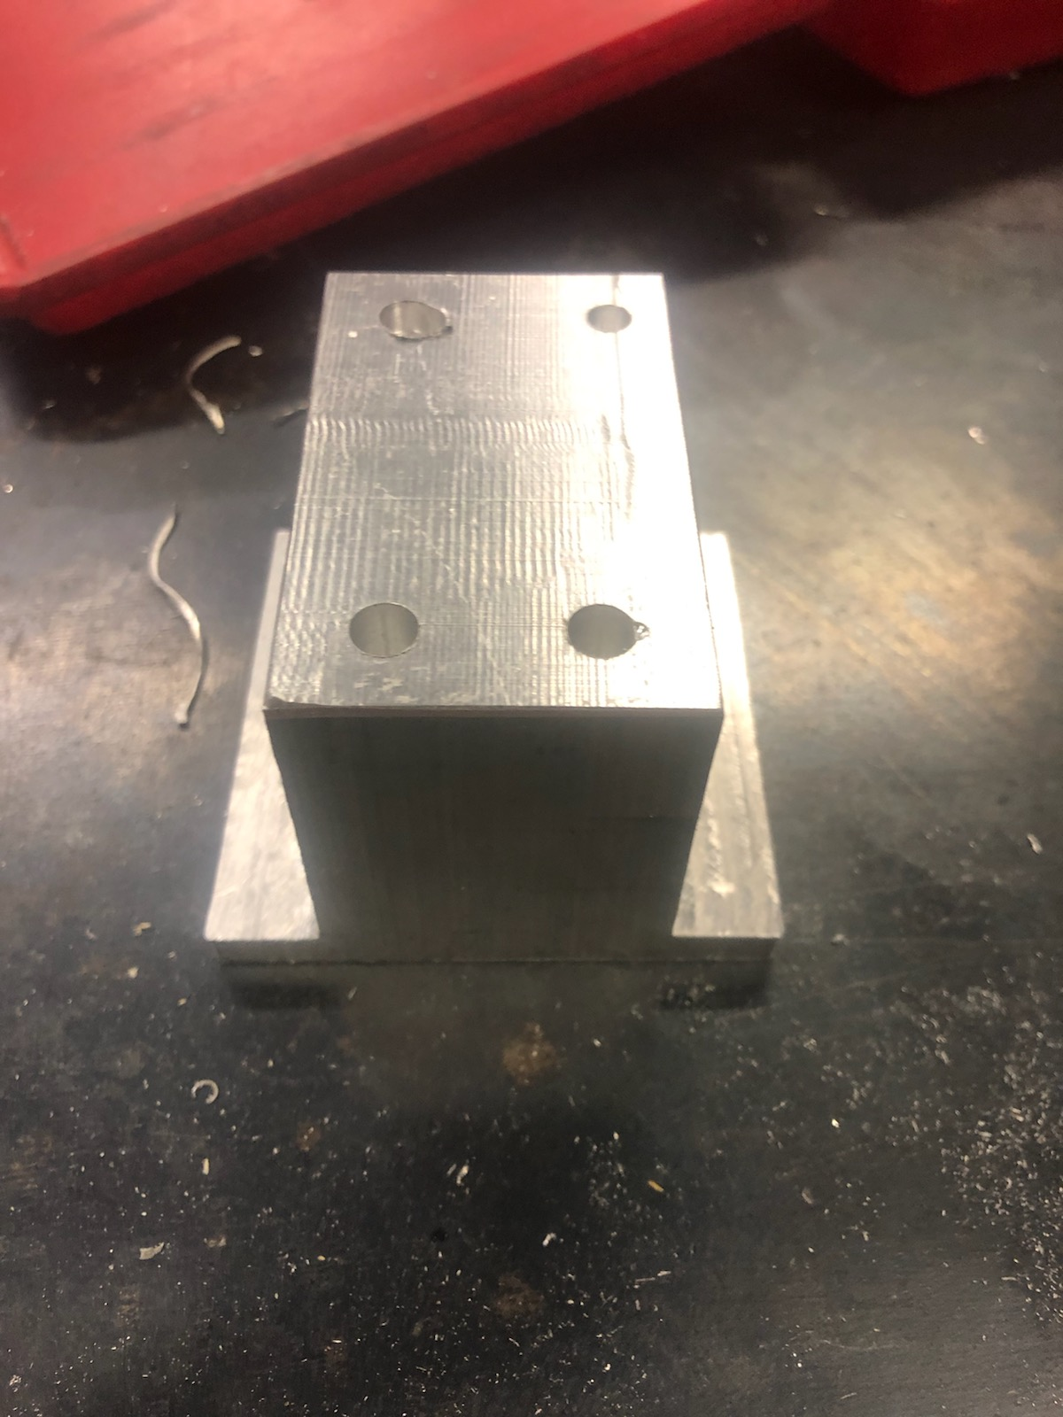
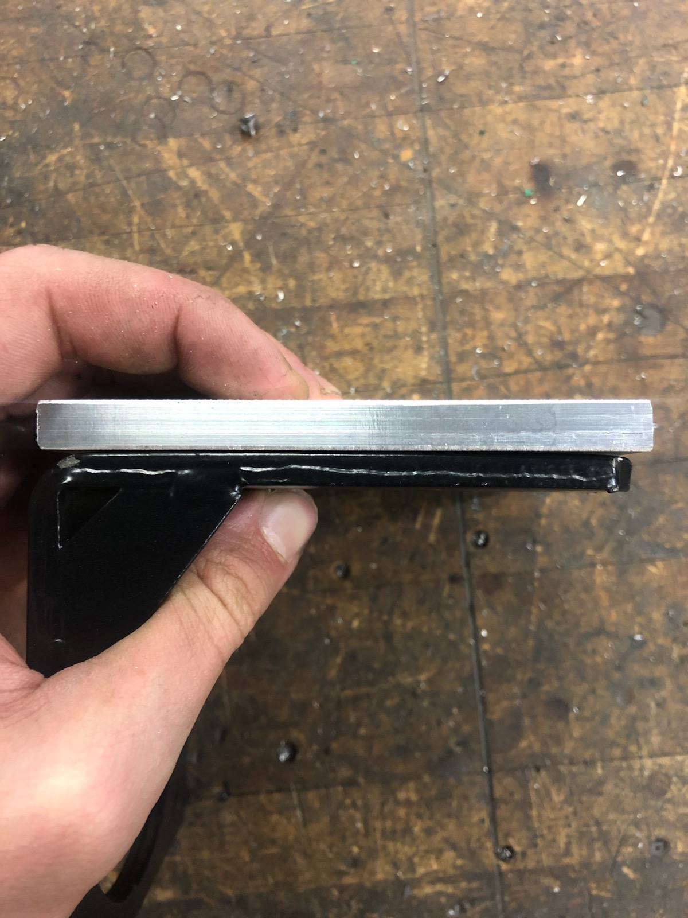
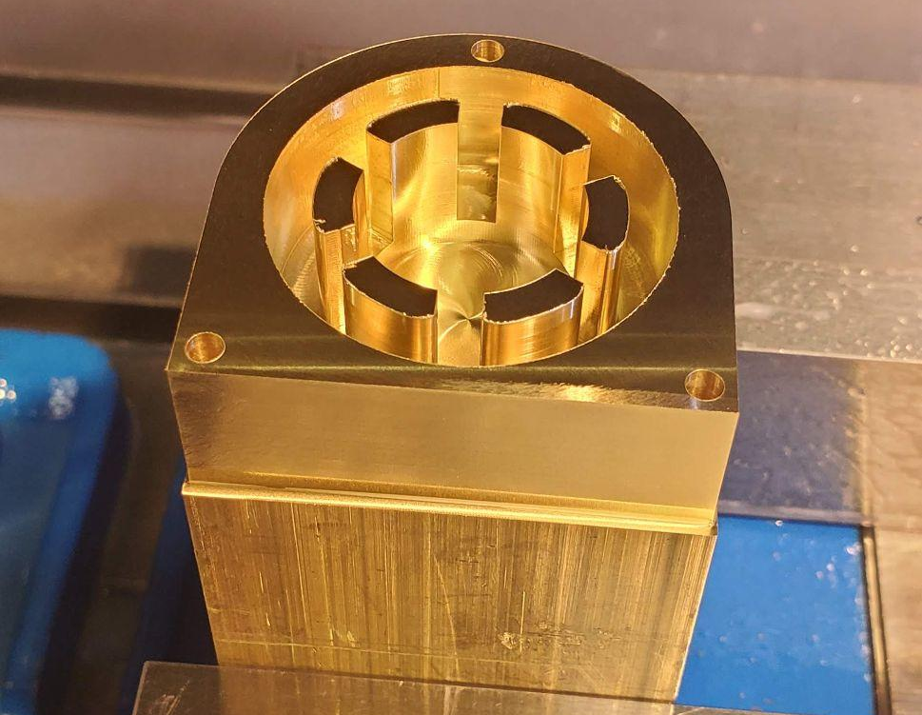
Manufacturing
Notes:
Vergil

Slide 19
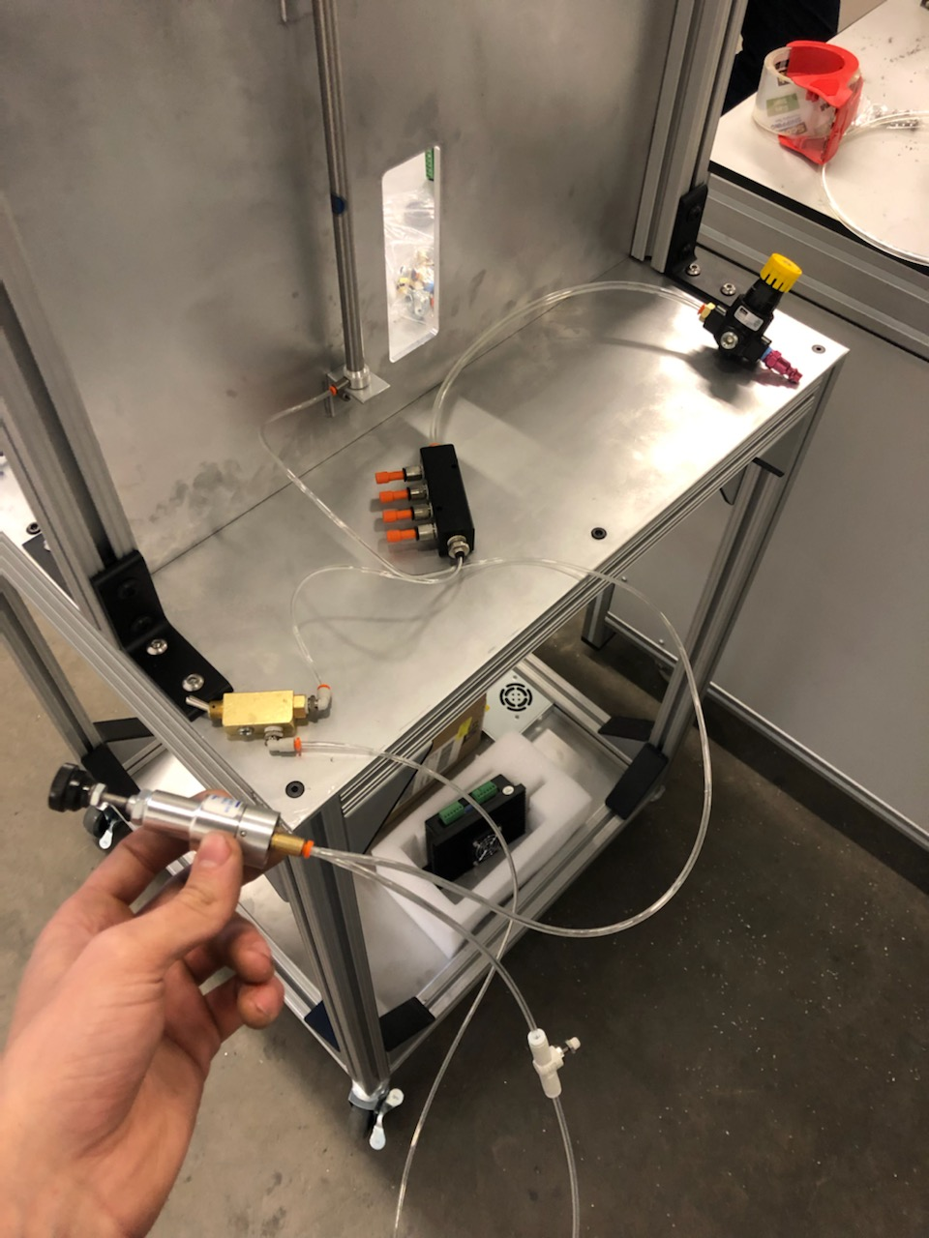
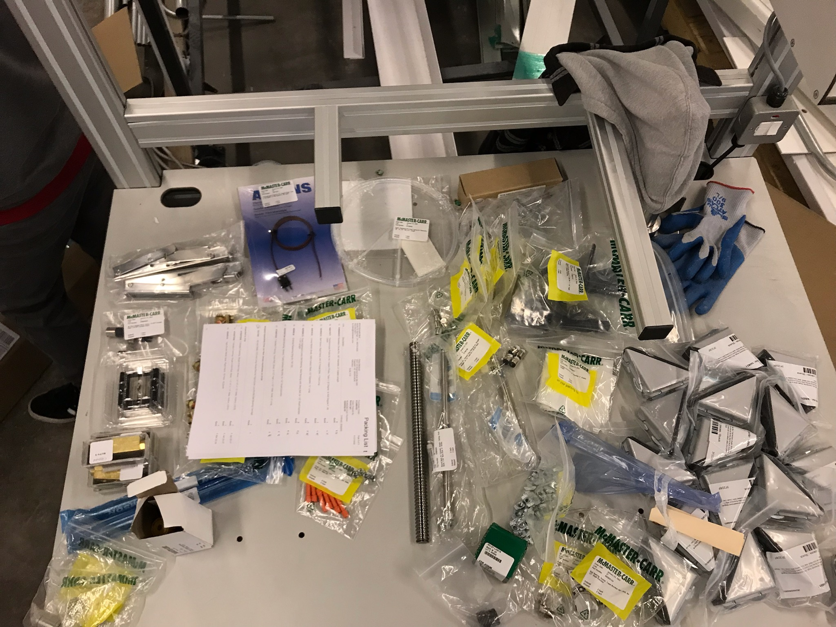
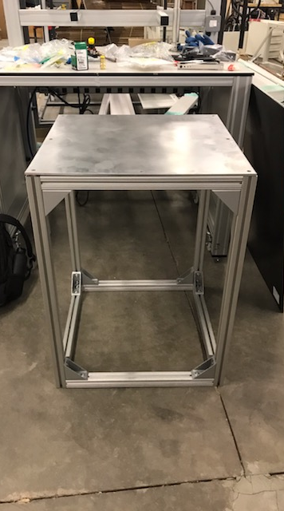
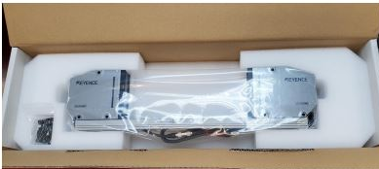
Assembly
Notes:
Vergil

Slide 20
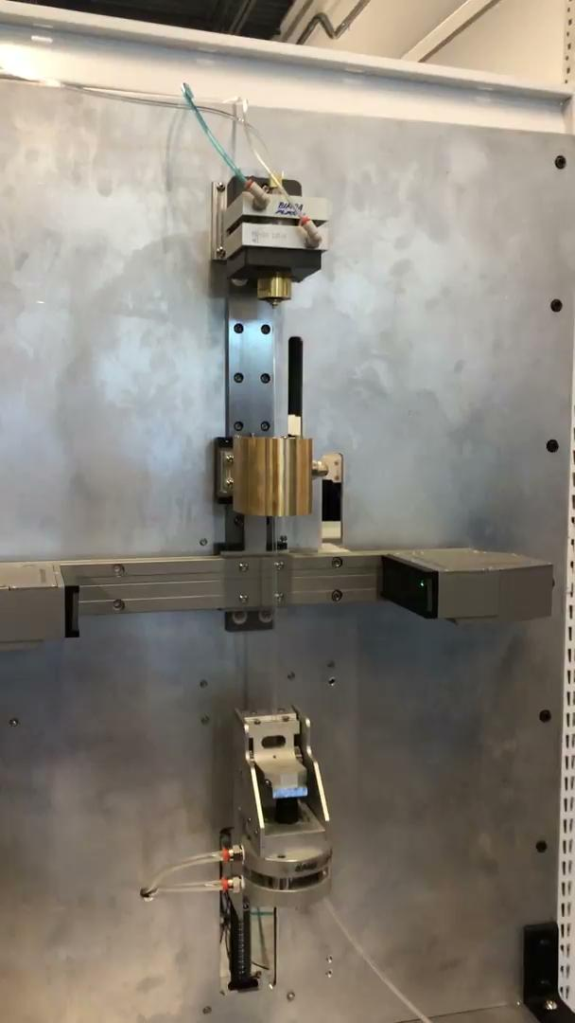
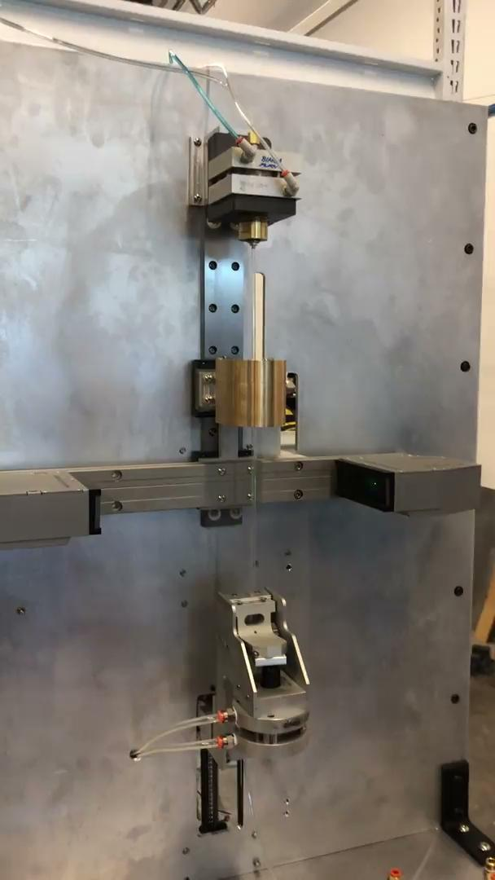
Full System Operation Video
Notes:
Michael

Slide 21
Testing Results
Machine is fully capable of testing all extrusion material and size configurations
Settings can be controlled to achieve any result from necking to expanding and popping
Temperature (C) | Pressure (psi) | Flow (CFM) | Material | Change in Diameter
200 | 100 | .25 | Nylon | -.0242
230 | 100 | .15 | Nylon | -.0256
230 | 100 | .1 | Nylon | -.0256
150 | 100 | .2 | Pebax (Soft) | Popped
200 | 100 | .2 | Pebax (Soft) | Popped
200 | 100 | .2 | Pebax (Soft) | Popped
150 | 100 | .2 | Pebax (Hard) | -.015
200 | 100 | .2 | Pebax (Hard) | Popped
Notes:
Michael

Slide 22
Budget
Subsystem | Supplier | Cost ($)
Linear Actuation | Mcmaster-Carr | 382.92
Heating | Omega Engineering | 241.03
Pneumatics | Mcmaster-Carr | 463.64
General Hardware | Mcmaster-Carr | 1,631.43
Clamping | Bimba | 166.60
Raw Stock | Online Metals | 365.67
Electrical System | Stepper Online | 144.63
Micrometer | Keyence | 5,500.00
Originally, budget was set to $5,000 with room to expand to $10,000 if it proved necessary
It proved necessary very quickly, so our budget was set officially to $10,000
Actual total expenses came out to $9085.15, difference of $189.23
Total (Predicted) | 8,895.92
Total (Actual) | 9085.15
Notes:
Noah

Slide 23
Future Work
Device is fully functional right now, future work revolves around quality of life features
  Build Plexiglass enclosure
  Build Side-tables
Further data analysis to discover correlations between extrusion properties and balloon forming performance
Further Testing
  Team will perform both a DOE to ensure device reliably works, as well as an analysis on the heater to ensure temperature surrounding extrusion is 250 degrees fahrenheit
Capstone nameplate permanently affixed to baseplate
Hand off to Poba
Notes:
Noah

Slide 24
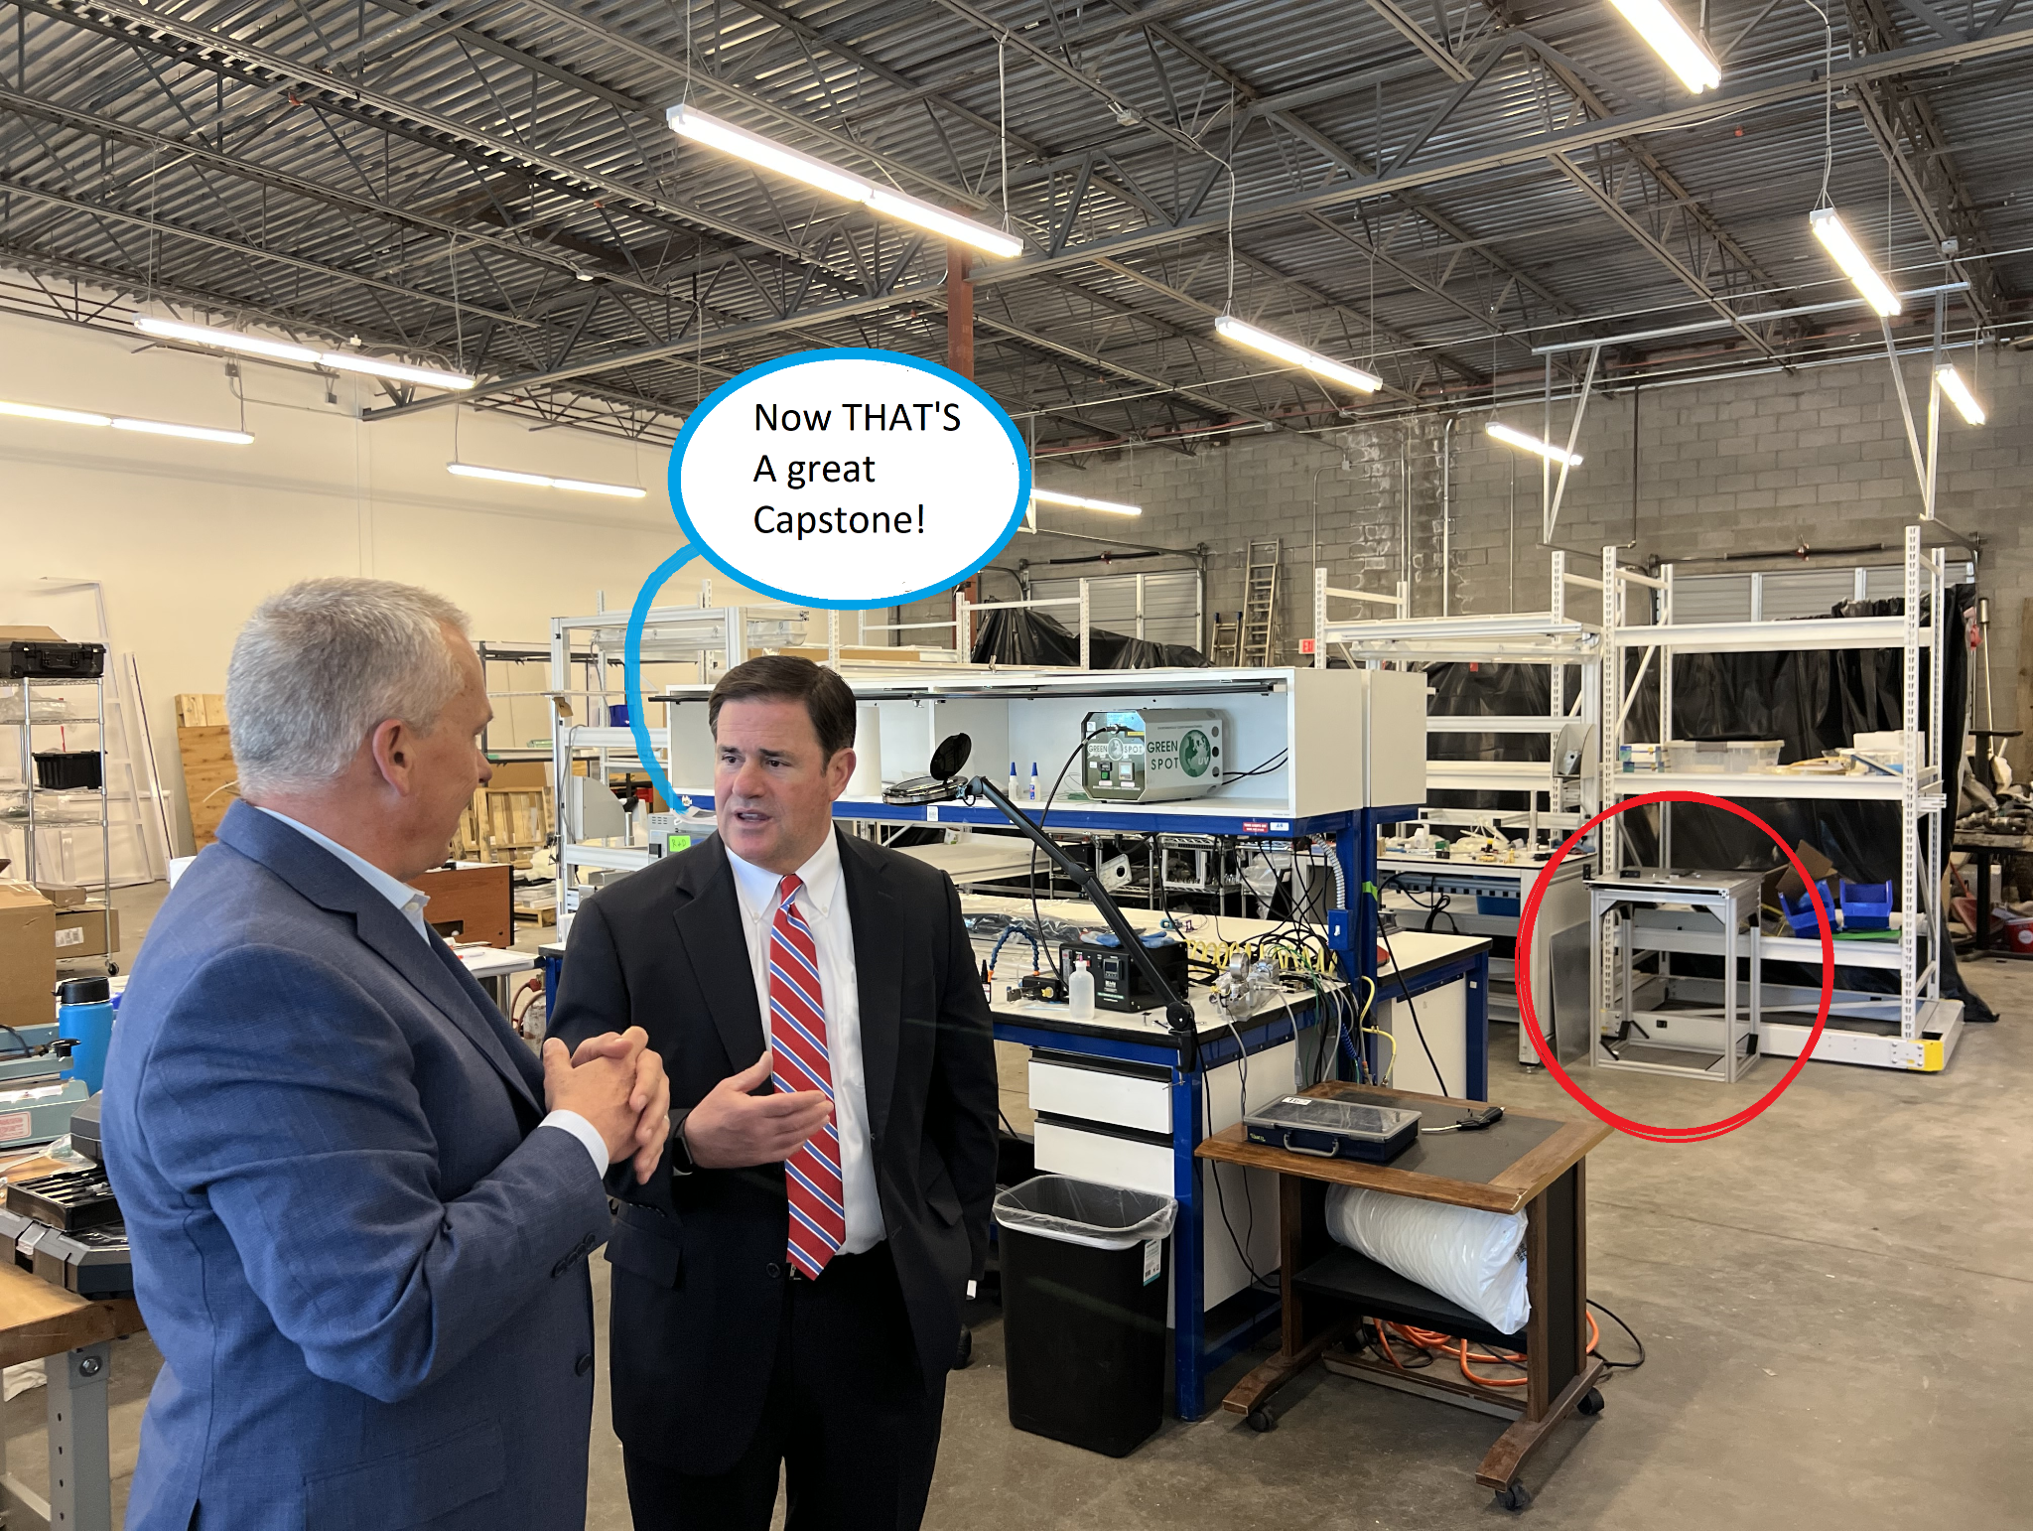
Notes:
…

Slide 25
Questions?

